Slide 1
Employee Attrition Factors
By Machine Churning Consulting
April 16, 2018

Slide 2
Employee Attrition
Dataset
Machine Churning
Data Analytics
Key Retention Factors
Machine Churning consulting is honored to be selected for Employee Attrition Factor data analytic project.
Our mission is to provide business intelligence to convert data into information and knowledge.
The Case Study dataset came from a undisclosed biomedical research agency who has experienced high employee turnover rate in recent years.

Slide 3
Project Input and Scope
Looking for Key employee retention factor!
Through data analytics for recommendations
data files input provided
CaseStudy2.xls – contains 1470 samples of employee records
Project Github repository:
https://github.com/tbitxyz/SMU-DDS-Machine-Churning-Project-2

Slide 4
Data Analysis – input data summary
## 'data.frame': 1470 obs. of 35 variables:
## $ Age : int 41 49 37 33 27 32 59 30 38 36 ...
## $ Attrition : Factor w/ 2 levels "No","Yes": 2 1 2 1 1 1 1 1 1 1 ...
## $ BusinessTravel : Factor w/ 3 levels "Non-Travel","Travel_Frequently",..: 3 2 3 2 3 2 3 3 2 3 ...
## $ DailyRate : int 1102 279 1373 1392 591 1005 1324 1358 216 1299 ...
## $ Department : Factor w/ 3 levels "Human Resources",..: 3 2 2 2 2 2 2 2 2 2 ...
## $ DistanceFromHome : int 1 8 2 3 2 2 3 24 23 27 ...
## $ Education : int 2 1 2 4 1 2 3 1 3 3 ...
## $ EducationField : Factor w/ 6 levels "Human Resources",..: 2 2 5 2 4 2 4 2 2 4 ...
## $ EmployeeCount : int 1 1 1 1 1 1 1 1 1 1 ...
## $ EmployeeNumber : int 1 2 4 5 7 8 10 11 12 13 ...
## $ EnvironmentSatisfaction : int 2 3 4 4 1 4 3 4 4 3 ...
## $ Gender : Factor w/ 2 levels "Female","Male": 1 2 2 1 2 2 1 2 2 2 ...
## $ HourlyRate : int 94 61 92 56 40 79 81 67 44 94 ...
## $ JobInvolvement : int 3 2 2 3 3 3 4 3 2 3 ...
## $ JobLevel : int 2 2 1 1 1 1 1 1 3 2 ...
## $ JobRole : Factor w/ 9 levels "Healthcare Representative",..: 8 7 3 7 3 3 3 3 5 1 ...
## $ JobSatisfaction : int 4 2 3 3 2 4 1 3 3 3 ...
## $ MaritalStatus : Factor w/ 3 levels "Divorced","Married",..: 3 2 3 2 2 3 2 1 3 2 ...
## $ MonthlyIncome : int 5993 5130 2090 2909 3468 3068 2670 2693 9526 5237 ...
## $ MonthlyRate : int 19479 24907 2396 23159 16632 11864 9964 13335 8787 16577 ...
## $ NumCompaniesWorked : int 8 1 6 1 9 0 4 1 0 6 ...
## $ Over18 : Factor w/ 1 level "Y": 1 1 1 1 1 1 1 1 1 1 ...
## $ OverTime : Factor w/ 2 levels "No","Yes": 2 1 2 2 1 1 2 1 1 1 ...
## $ PercentSalaryHike : int 11 23 15 11 12 13 20 22 21 13 ...
## $ PerformanceRating : int 3 4 3 3 3 3 4 4 4 3 ...
## $ RelationshipSatisfaction: int 1 4 2 3 4 3 1 2 2 2 ...
## $ StandardHours : int 80 80 80 80 80 80 80 80 80 80 ...
## $ StockOptionLevel : int 0 1 0 0 1 0 3 1 0 2 ...
## $ TotalWorkingYears : int 8 10 7 8 6 8 12 1 10 17 ...
## $ TrainingTimesLastYear : int 0 3 3 3 3 2 3 2 2 3 ...
## $ WorkLifeBalance : int 1 3 3 3 3 2 2 3 3 2 ...
## $ YearsAtCompany : int 6 10 0 8 2 7 1 1 9 7 ...
## $ YearsInCurrentRole : int 4 7 0 7 2 7 0 0 7 7 ...
## $ YearsSinceLastPromotion : int 0 1 0 3 2 3 0 0 1 7 ...
## $ YearsWithCurrManager : int 5 7 0 0 2 6 0 0 8 7 ...

Slide 5
Data Analysis – Data Cleaning
Making sure no “NA” exist
Drop categorical variables with single level
Drop variables that does not make sense for attrition analysis
Employee Number
Daily Rate,
Hourly Rate
Monthly Rate

Slide 6
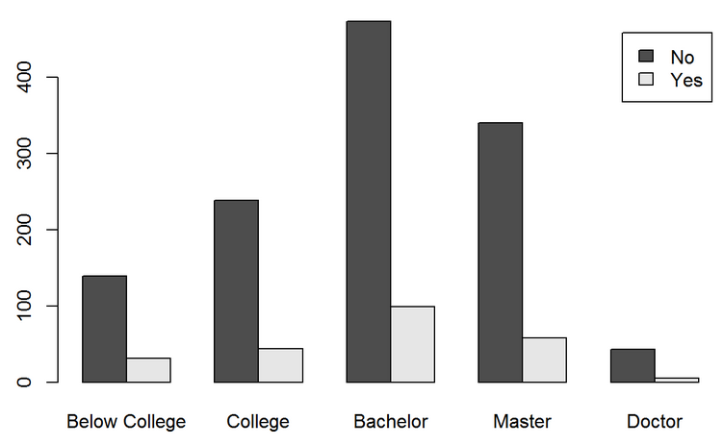
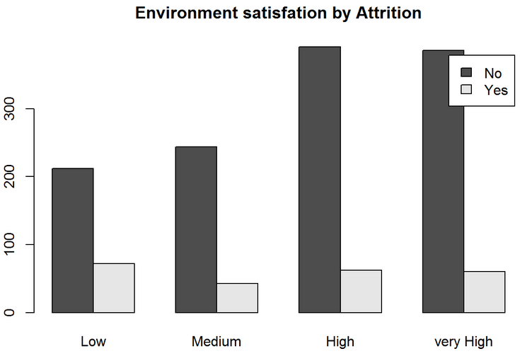
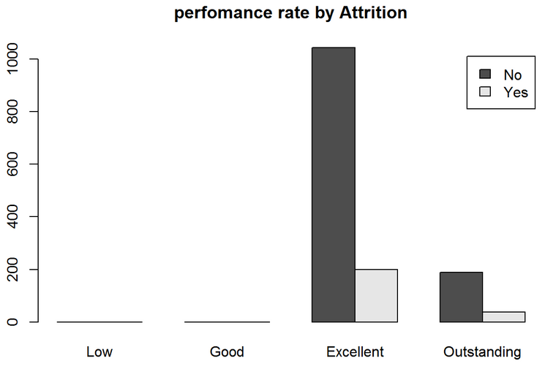
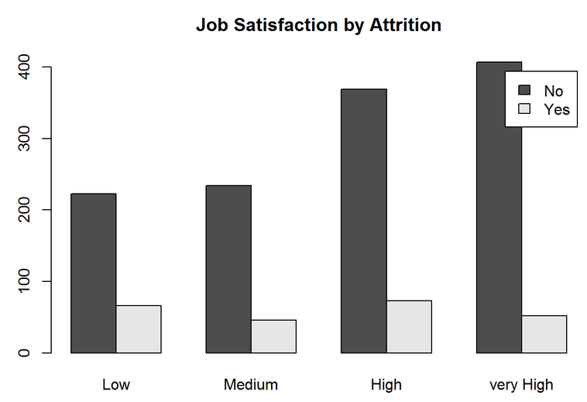
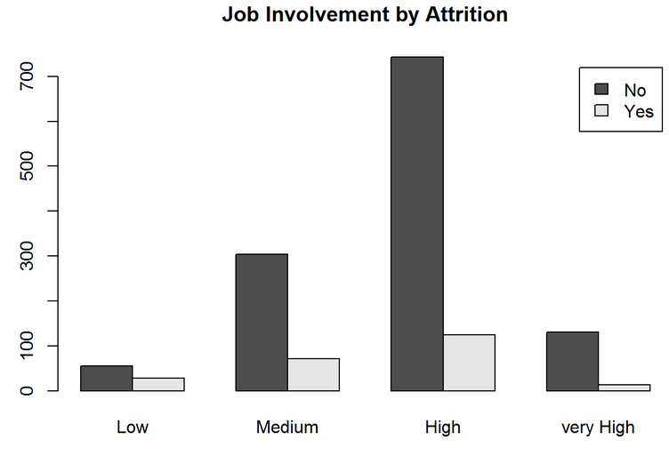
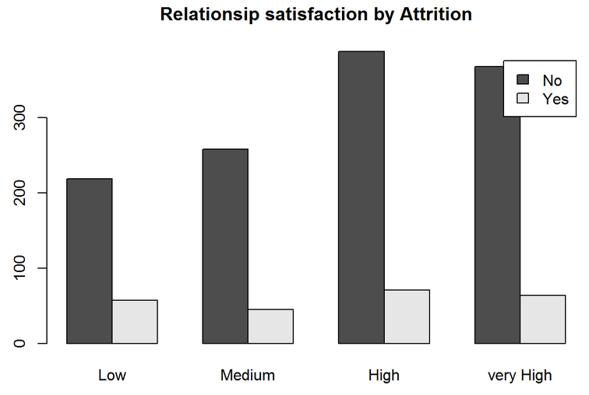
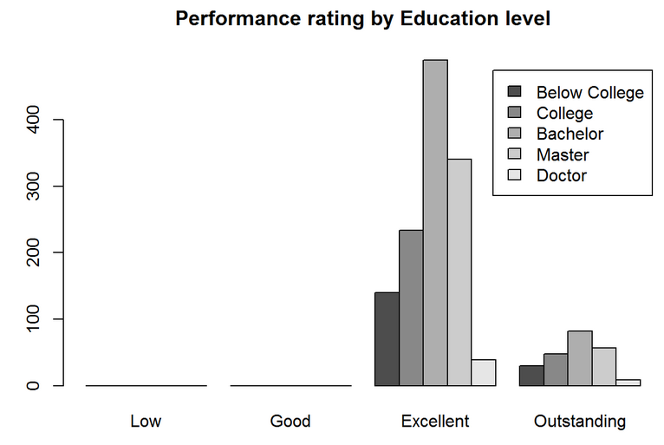
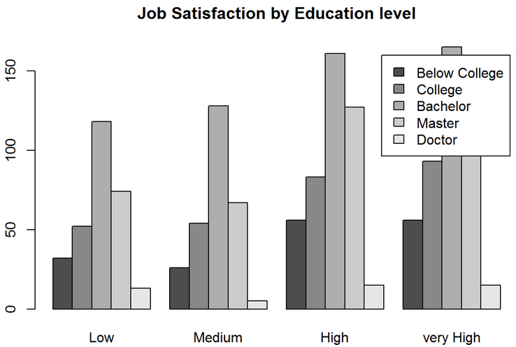
Data Analysis – exploratory analysis

Slide 7
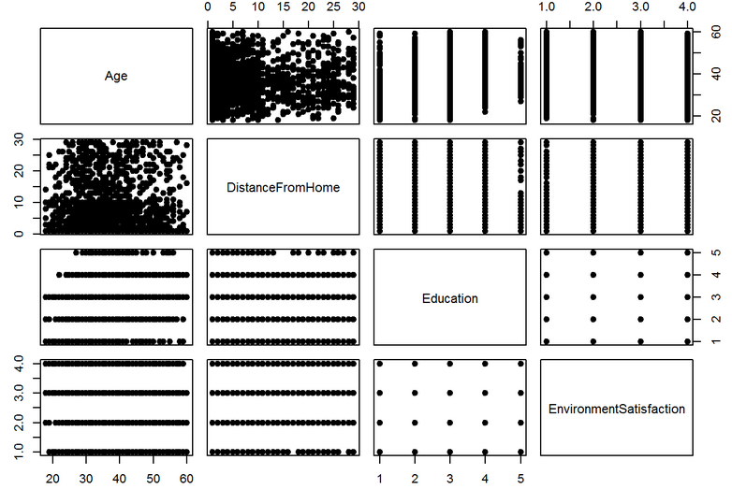
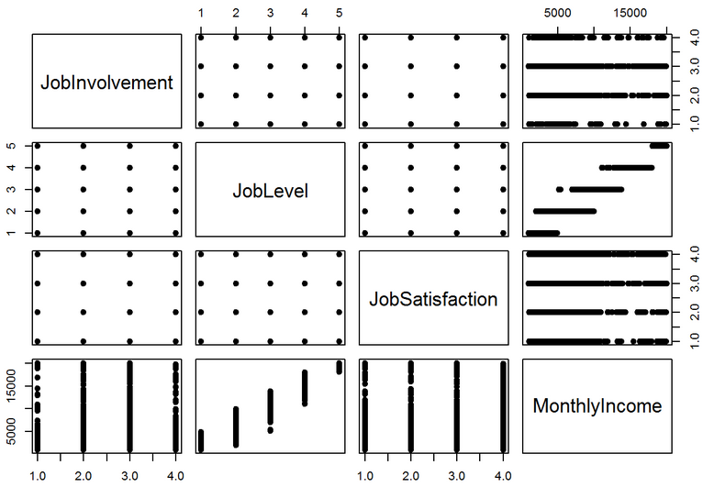
Data Analysis – exploratory analysis

Slide 8
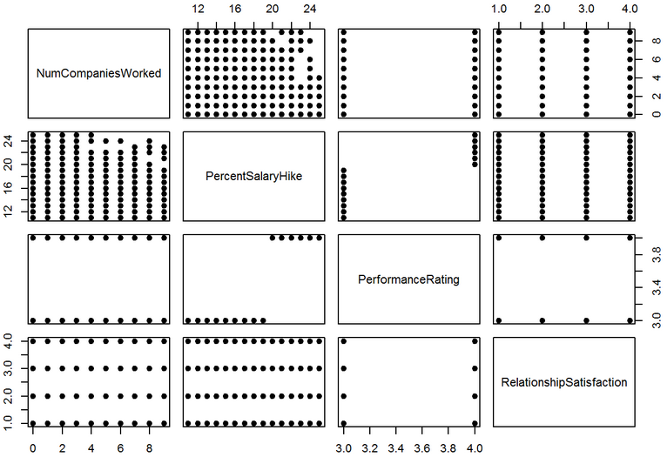
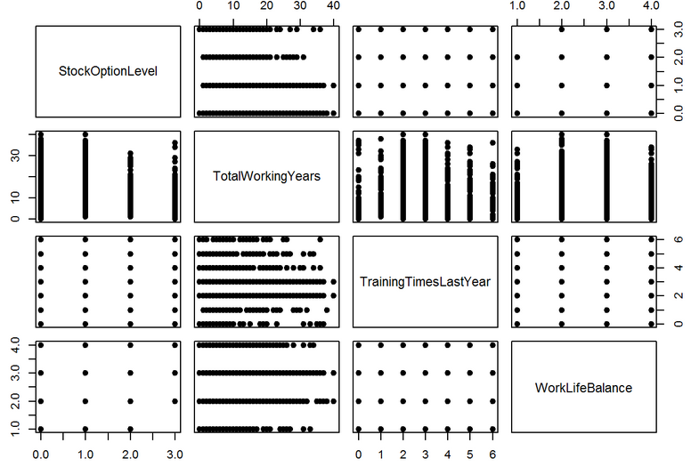
Data Analysis – exploratory analysis

Slide 9
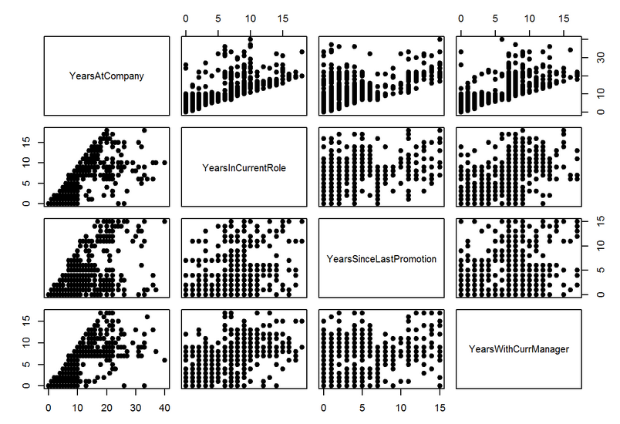
Data Analysis – exploratory analysis

Slide 10
Data Analysis – Reformat Data
Based on scatter plot visual result, we cross check with correlation function with all interested variables and decide to do following data reformatting
combine variables with strong correlation
AgeIncomeLevel = Age+JobLevel*MonthlyIncome
Years = YearsAtCompany+TotalWorkingYears+YearsInCurrentRole+YearsSinceLastPromotion+YearsWithCurrManager

Slide 11
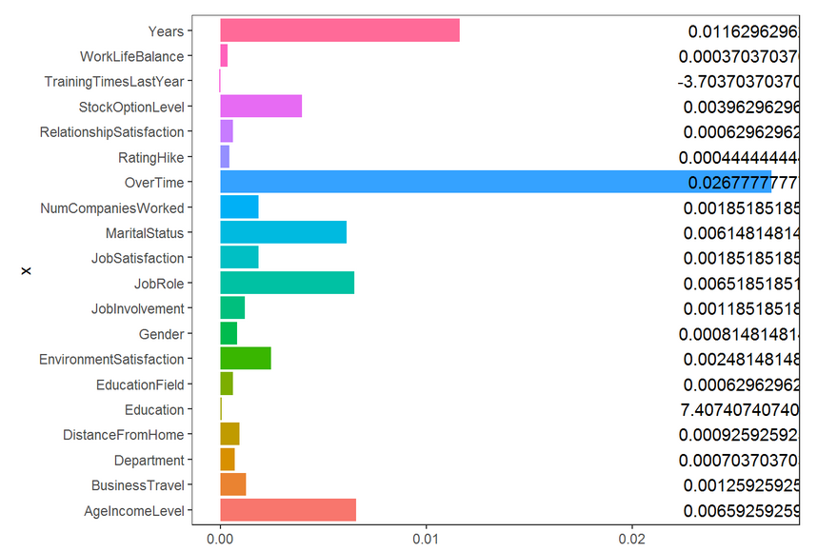
Data Analysis – Random Forest importance analysis
cf1 <- cforest(Attrition ~ . , data= turnover5, control=cforest_unbiased(mtry=5,ntree=50))
importance<-varimp(cf1) # get variable importance, based on mean decrease in accuracy
ggplot(importance3, aes(x,y, fill=x)) + geom_bar(stat="identity")+ coord_flip()+
geom_text(aes(y=max(y), label=y), color="black")+
scale_fill_discrete(guide="none")+
theme_bw()+theme(panel.grid=element_blank())
cforest importance analysis shows "over time" is the number one contributing factor for Attrition. Followed by Years and AgeIncomeLevel.
Notes:
https://stats.stackexchange.com/questions/159444/variable-importance-in-party-vs-randomforest?utm_medium=organic&utm_source=google_rich_qa&utm_campaign=google_rich_qa
Traditional Random Forest uses "Gini Gain" splitting criterion in assessing Variable Importance, which is biased towards factor variables with many levels/categories. In contract, cforest function creates random forests not from CART trees, but from unbiased classification trees based on conditional inference, which gives much more robust results when multifactorial variables are involved, particularly when the function is used with subsampling without replacement. Here's a good paper that explains the differences more in depth:
Bias in random forest variable importance measures: Illustrations, sources and a solution. Strobl et al. (2007)

Slide 12
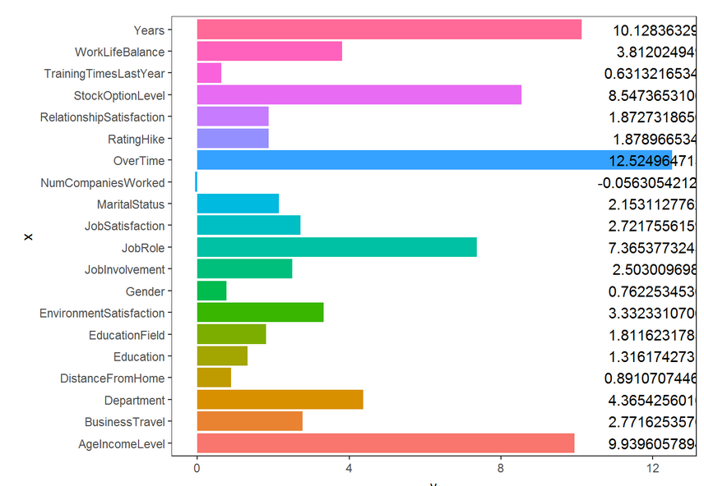
Data Analysis – Random Forest importance analysis
model.rf <- randomForest(Attrition~., turnover5, ntree=100, proximity=TRUE, importance=TRUE)
meande<-importance(model.rf, type=1)
ggplot((meande6), aes(x,y, fill=x)) + geom_bar(stat="identity")+ coord_flip()+
geom_text(aes(y=max(y), label=y), color="black")+
scale_fill_discrete(guide="none")+
theme_bw()+theme(panel.grid=element_blank())
This clearly agrees with cforest package analysis result, that is "over time" is the dominant factor for Attrition. There are few secondary factors include "Years" which is a aggregate of several length of service varibles; "AgeIncomeLevel" which is another aggregate varible for Age, Job Level and Monthly Income.

Slide 13
Data Analysis – conclusion
Recommend to pay attention to employee benEfit overall packages!!
From the give historical dataset analysis, we can clearly tell competitive pay, with proper live and work balance will attract employee to stay long term with the company.
Overtime is the number one contributor for employee turnover, this shows stressful working environment with constant overtime hours required push the employee to look elsewhere.
Length of service on the job is another key factor. this tells us we should encourage employee to learn new skills, encourage job rotation. It is human nature to like the daily life with some channelings, same business as usual bore people to death.
Income is KEY! Company should pay attention to industry pay norm, especially for high performance employees.
from academic stand point, the analysis was done on observation data provided. Given we have not validated how the data is collected and its validity, we can only say that the result applies to data input population.
From practical stand point, we assume input data are valid from client and it does represent overall market situation, it is a good random collections of data sample. Therefore, analysis result is valid.

